Slide 1
Learning Unit 6 Persistent Data
Files and Databases

Slide 2
Objectives
Review the use of key-Value data.
Understand and use of Files.
Utilize Android Databases - SQLite.
Apply Android best practices with Persistent Data
Apply storing data in practical applications.

Slide 3
Shared Preferences
Learning Unit 5

Slide 4
Introduction to Persistent Data
Android provides different data storage options available on Android:
Shared preferences: Store private primitive data in key-value pairs.
Internal file storage: Store app-private files on the device file system.
External file storage: Store files on the shared external file system. This is usually for shared user files, such as photos.
Databases: Store structured data in a private database.
See Last unit slides

Slide 5
Files
Learning Unit 6

Slide 6
Saving Files
a file system that's similar to disk-based file systems on other platforms.
A ‘File’ object is suited to reading or writing large amounts of data
good for images, network, audio
two file storage areas: "internal" and "external" storage.

Slide 7
Permissions
Internal storage:
is always available
files saved here are accessible by only your app by default
When the user uninstalls your app, the system removes all your app's files from internal storage (and external if available).
External storage:
To write to the external storage, you must request the WRITE_EXTERNAL_STORAGE permission in your manifest file:
Recommended to declare the READ_EXTERNAL_STORAGE permission
<manifest ...>
<uses-permission android:name="android.permission.WRITE_EXTERNAL_STORAGE" />
...
</manifest>

Slide 8
Writing a File:
Internal Storage:
acquire the appropriate directory as a File by calling one of two methods:
getFilesDir()
Returns a File representing an internal directory for your app.
getCacheDir()
Returns a File representing an internal directory for your app's temporary cache files.
External Storage:
Availability and volume need check before use:
getExternalStorageState() If the returned state is equal to MEDIA_MOUNTED, then you can read and write your files.
private fun isExternalStorageWritable(): Boolean {
return Environment.getExternalStorageState() == Environment.MEDIA_MOUNTED
}

Slide 9
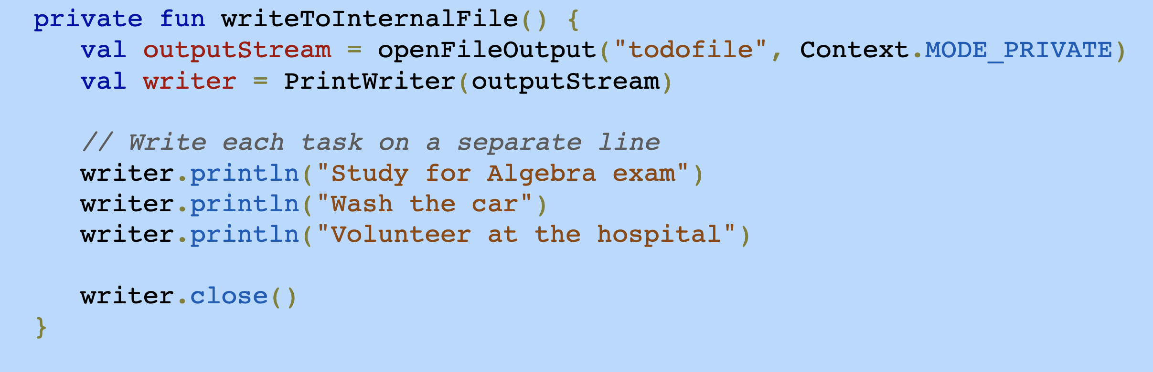
Writing a File:

Slide 10
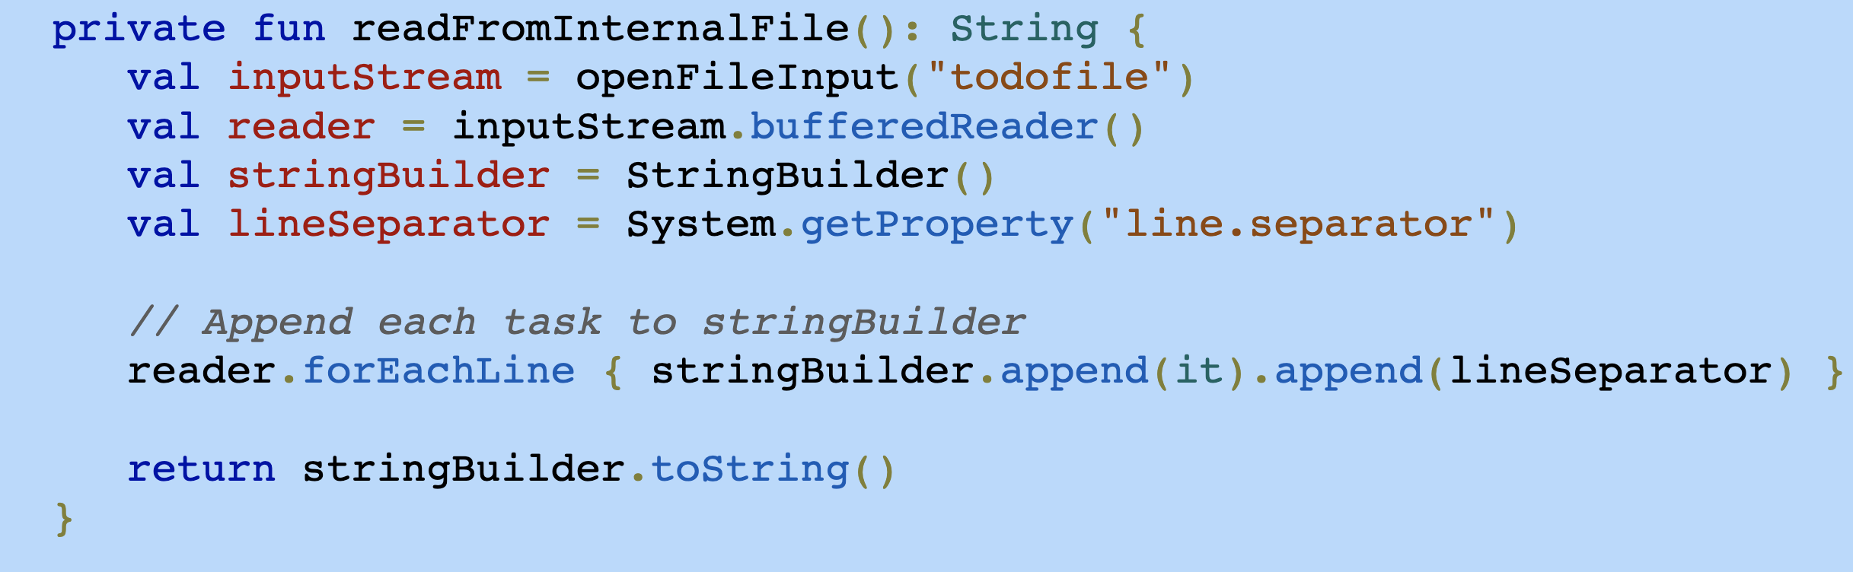
Reading a File
In order to read from the file, call the openFileInput() - method with the name of the file. It returns an instance of FileInputStream.
Notes:
private fun readFromInternalFile(): String {
val inputStream = openFileInput("todofile")
val reader = inputStream.bufferedReader()
val stringBuilder = StringBuilder()
val lineSeparator = System.getProperty("line.separator")
// Append each task to stringBuilder
reader.forEachLine {
stringBuilder.append(it).append(lineSeparator)
}
return stringBuilder.toString()
}

Slide 11
Delete a File
You should always delete files that you no longer need. The most straightforward way to delete a file is to have the opened file reference call delete() on itself.
If the file is saved on internal storage, you can also ask the Context to locate and delete a file by calling deleteFile():
myFile.delete();
myContext.deleteFile(fileName);
Notes:
CSIT451 to start with standard SQL demo

Slide 12
Databases
Learning Unit 6

Slide 13
SQLite
Embedded RDBMS
ACID Compliant
Size – about 257 Kbytes
Not a client/server architecture
Accessed via function calls from the application
Writing (insert, update, delete) locks the database, queries can be done in parallel

Slide 14
SQLite
Datastore – single, cross platform file (kinda like an MS Access DB)
Definitions
Tables
Indicies
Data

Slide 15
SQLite Data Types
This is quite different than the normal SQL data types so please read: https://www.sqlite.org/docs.html

Slide 16
Storage classes
NULL – null value
INTEGER - signed integer, stored in 1, 2, 3, 4, 6, or 8 bytes depending on the magnitude of the value
REAL - a floating point value, 8-byte IEEE floating point number.
TEXT - text string, stored using the database encoding (UTF-8, UTF-16BE or UTF-16LE).
BLOB. The value is a blob of data, stored exactly as it was input.

Slide 17
android.database.sqlite
Contains the SQLite database management classes that an application would use to manage its own private database.

Slide 18
android.database.sqlite - Classes
SQLiteCloseable - An object created from a SQLiteDatabase that can be closed.
SQLiteCursor - A Cursor implementation that exposes results from a query on a SQLiteDatabase.
SQLiteDatabase - Exposes methods to manage a SQLite database.
SQLiteOpenHelper - A helper class to manage database creation and version management.
SQLiteProgram - A base class for compiled SQLite programs.
SQLiteQuery - A SQLite program that represents a query that reads the resulting rows into a CursorWindow.
SQLiteQueryBuilder - a convenience class that helps build SQL queries to be sent to SQLiteDatabase objects.
SQLiteStatement - A pre-compiled statement against a SQLiteDatabase that can be reused.

Slide 19
android.database.sqlite.SQLiteDatabase
Contains the methods for: creating, opening, closing, inserting, updating, deleting and quering an SQLite database
These methods are similar to JDBC but more method oriented than what we see with JDBC (remember there is not a RDBMS server running)

Slide 20
Room Database
The Room persistence library provides an abstraction layer over SQLite, allowing developers to write significantly simpler code to interact with a SQLite database.
Room is an ORM library. An object-relational mapping (ORM) library is software that converts objects in an object-oriented programming language into tables and queries in a relational database.
Some knowledge of relational databases and SQL is helpful when using Room.

Slide 21
Room compoenents
Room defines three components:
Entity is a class annotated with @Entity that defines the columns and keys of a database table.
DAO (Data Access Object) is an interface annotated with @Dao that defines methods for selecting, updating, inserting, and deleting entities in a database.
Database is an abstract class annotated with @Database that inherits from the RoomDatabase class and provides DAOs for accessing the database.

Slide 22
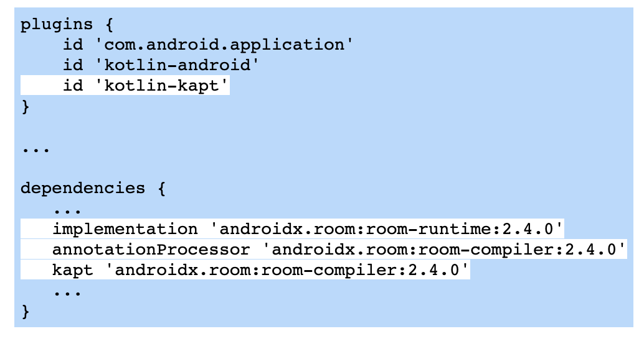
Room dependences
Room dependencies for app module's build.gradle file.
Notes:
plugins { id 'com.android.application' id 'kotlin-android' id 'kotlin-kapt' } ... dependencies { ... implementation 'androidx.room:room-runtime:2.4.0' annotationProcessor 'androidx.room:room-compiler:2.4.0' kapt 'androidx.room:room-compiler:2.4.0' ... }

Slide 23
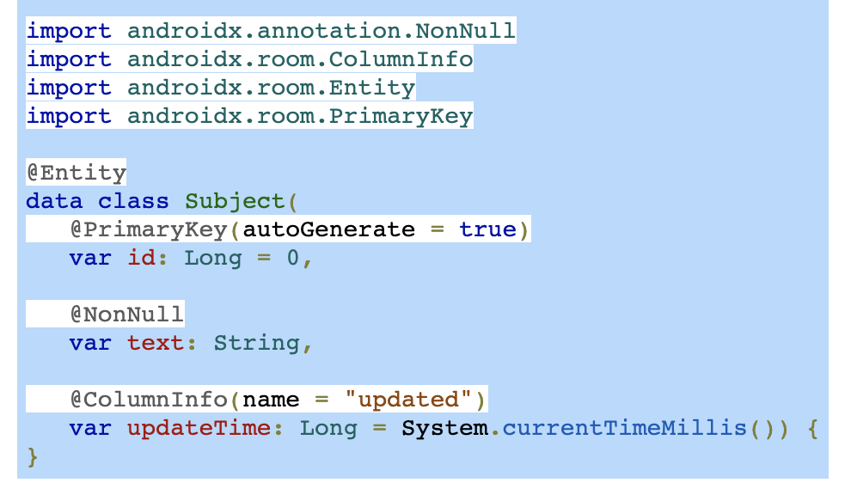
Entities
A SQLite table is created for each entity class, and the entity's fields define the table columns. The figure below defines the Subject entity. Several annotations are used:
@Entity designates the entity class. The class name is used to name the table unless the optional tableName property specifies a different table name.
@PrimaryKey designates which field is the table's primary key. An entity must have at least one field annotated with @PrimaryKey. Typically the primary key is an integer or long field. Setting the autoGenerate property to true makes SQLite automatically generate unique numbers for the primary key.
@NonNull indicates the field should not be null. SQLite does not allow a primary key to be null.
@ColumnInfo with the name property specifies a column name for a field. If @ColumnInfo is not present, the field's name is used to name the column.

Slide 24
Data Access Objects
The @Dao annotation designates a DAO's public interface that defines methods to select, insert, update, and delete database entities.
Room implements the interface automatically, writing all the code necessary to interact with SQLite.
@Query designates a database query, usually a SELECT statement, to be executed. The query can bind parameters from the abstract method.
Ex: The @Query for getSubject() has an :id parameter that matches the id parameter in getSubject().
The return value for a @Query method matches the data returned by the SELECT statement. Ex: getSubjects() returns List<Subject> as the SELECT statement selects multiple rows from the table.
@Insert designates an insert query, which inserts a new entity into the database using an INSERT statement. The onConflict property indicates what the database should do if the entity being inserted already exists.
The return value for an @Insert method is a long when the INSERT statement inserts a row with an auto-incremented ID. The new ID is returned by the @Insert method.
@Update designates an update query, which updates an existing entity in the database using an UPDATE statement.
@Delete designates a delete query, which deletes an entity from the database using a DELETE statement.

Slide 25
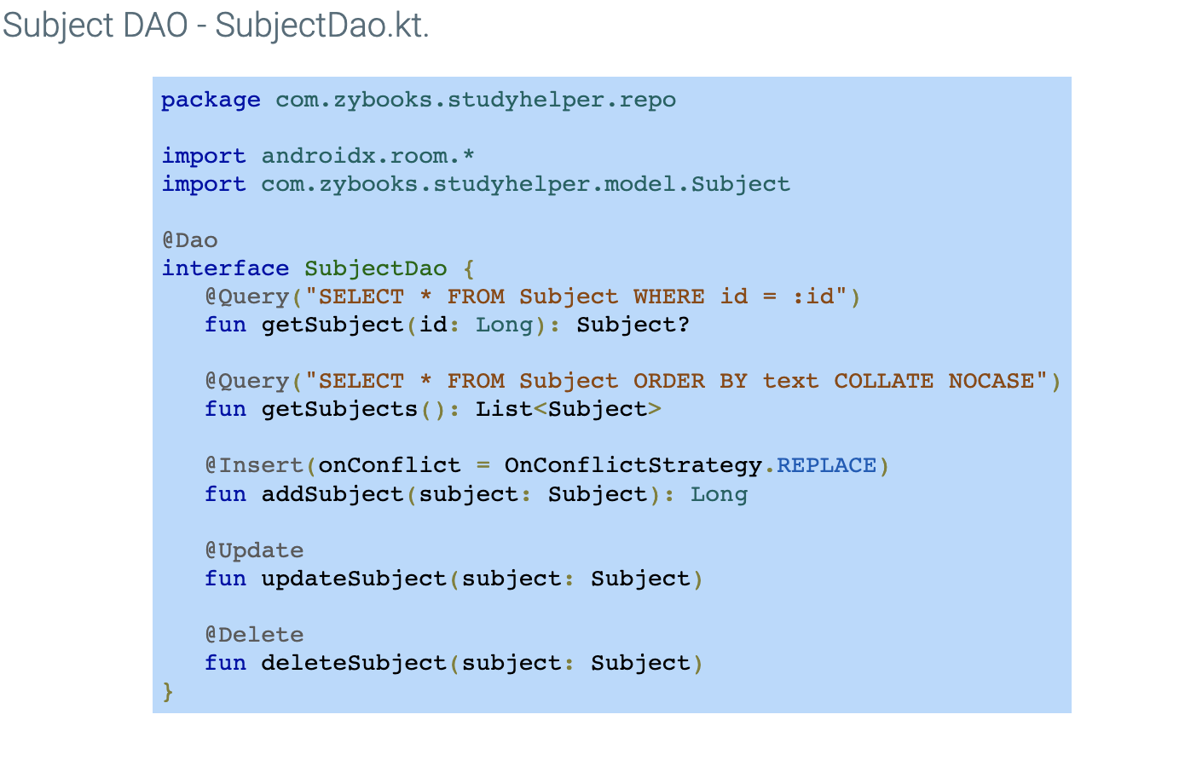

Slide 26
Room database
The Room database class is an abstract class that inherits from RoomDatabase, the base class for all Room databases. The @Database annotation designates the Room database class and uses the property entities to name the database's entities and version to name the database version number.
import androidx.room.Database
import androidx.room.RoomDatabase
import com.zybooks.studyhelper.model.Question
import com.zybooks.studyhelper.model.Subject
@Database(entities = [Question::class, Subject::class], version = 1)
abstract class StudyDatabase : RoomDatabase() {
abstract fun subjectDao(): SubjectDao
}

Slide 27
Thank you
In this learning unit we discussed:
Shared Preferences
Files
Internal
External
Databases

